Slide 1

DriverPass
System Analysis
Jeremy Brown
Notes:
[No speaker notes required for this slide.]

Slide 2

System Requirements
Functional Requirements
  The system shall validate user credentials when logging in.
  The system shall allow users to book driving lessons via an online interface.
Nonfunctional Requirements
  The system is in a web-based environment, allowing access from any computer or mobile device.
  The system will distinguish between users based on roles such as students, instructors, and administrators.
Notes:
System requirements are essential the requirements that the system needs to meet. Functional requirements are described as what the system does. In this case, the functional requirements shown here are that the system will make sure that each person logging into the system is the intended person and that the system will be used to let each user schedule lessons. By ensuring that only authorized individuals can access the system, this is meeting DriverPass's needs by ensuring that every account is secure. On top of that, the system allowing each user is meeting DriverPass's needs by promoting convenience for the user.
Nonfunctional requirements describe how the system behaves. As shown above, two of these nonfunctional requirements are that the system must be accessible through the internet and that the system must be able to tell students apart from instructors or administrators. The system being accessible through the internet meets DriverPass's needs by allowing the system to be accessed through a larger medium, meaning that they can provide their services to a larger audience. Allowing the system to differentiate between different kind of users meets DriverPass's needs by promoting further security as a student won't be able to interact with the system the same way an administrator would.

Slide 3
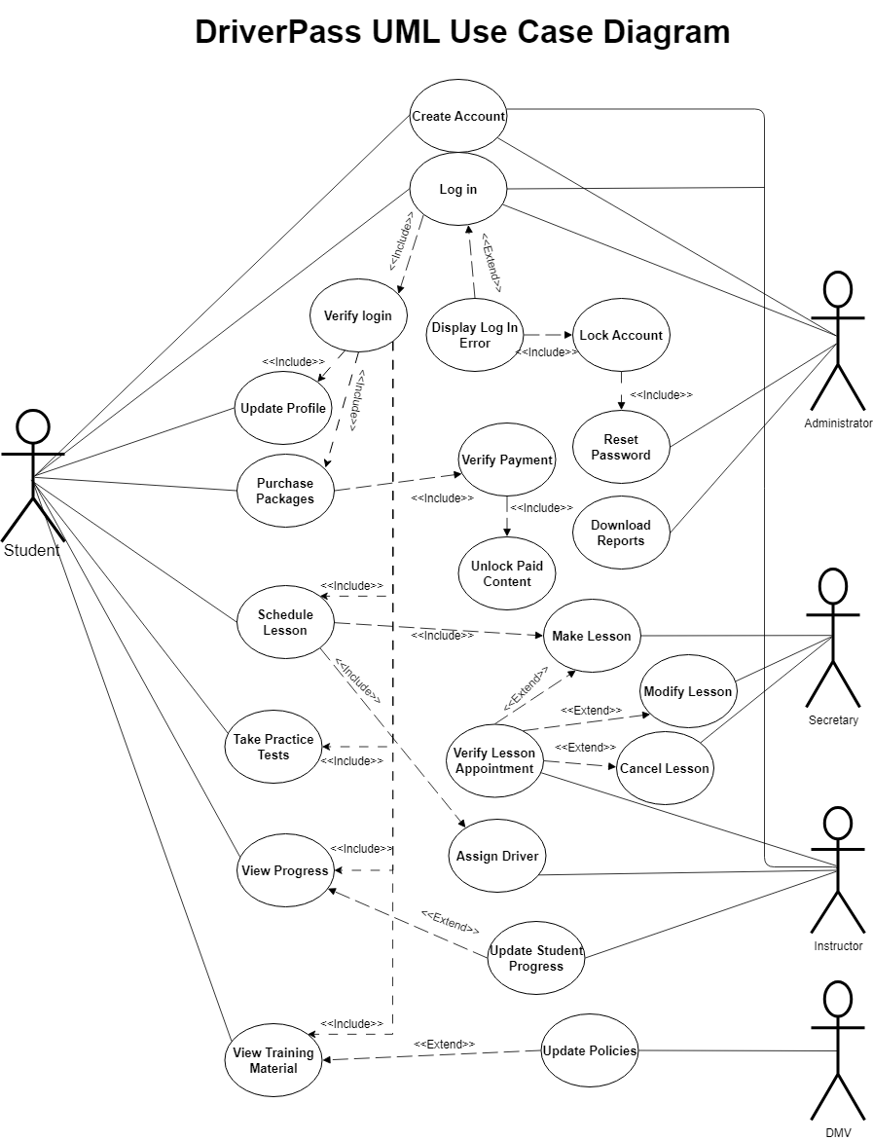
Use Case Diagram
[Insert your use case diagram here.]
Notes:
This is a use case diagram, which is used to showcase how different people may interact with the system. The people shown here are students, administrators, instructors, secretaries, and the DMV. Students interact with the system by making an account, logging in, modifying their profile, purchasing packages, scheduling lessons, taking practice tests, viewing their progress and viewing training materials. Administrators interact with the system by creating accounts, logging in, resetting passwords, and downloading reports. Secretaries interact with the system by making, modifying, and cancelling lessons. Instructors are able to update student progress on lessons, assign drivers for lessons, and verify upcoming lessons. Lastly, the DMV interacts with the system by updating their policies, which in turn updates training materials.
This all accounts for DriverPass's needs by making the user experience straightforward and accessible. Features are designed to cater to each group, allowing them to perform their tasks efficiently while ensuring the system remains secure and user-friendly.

Slide 4
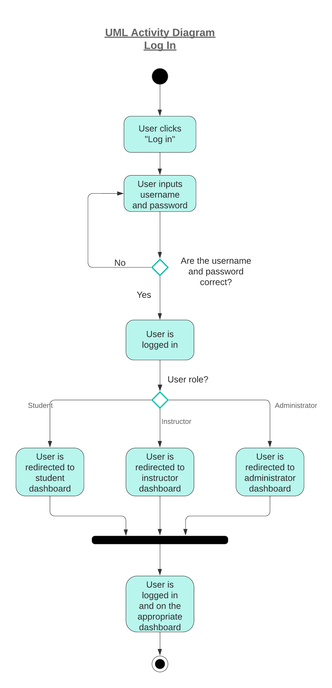
Activity
Diagram
Notes:
This is an activity diagram. This diagram is essential a breakdown of one of the actions from the previous diagram. Here I break down the process of a user logging in, starting with the user clicking "log in" on the DriverPass site. Next, the user puts in their username and password. If the username and password are incorrect, the user is prompted to try again. Once the correct information is put in, the system will check the role that corresponds to their account. For example, if the user is a student, they are taken to the student dashboard. Once the user is taken to the appropriate dashboard, this process is considered complete. I have taken into account DriverPass's needs in my design by incorporating role-based access, ensuring people in the correct role can only access what is relevant to their role.

Slide 5
Security
This design addresses the following security concerns:
  Role-based access
  User Authentication
Notes:
My design address two security concerns. Firstly, role-based access is incorporated in the design by differentiating between user roles on log in. When the user logs in, they are directed immediately to the dashboard for their role where they will have immediate access to the actions they can perform with their role. For example, it would be a major security concern if a student could do the same actions as a administrator because administrators have a greater ability to interact with the system's architecture. Secondly, user authentication is addressed in my design. By having the user log in using the username and password associated with their account, we are ensuring that only the intended individual is accessing the system.

Slide 6
System Limitations
Assumes user has stable internet
System updates
Security
Notes:
One limitation in the design is that the system depends on users having a stable internet connection. Because offline access is not included in this design, if someone has trouble with their internet, they might not be able to log in or book driving lessons smoothly. Another limitation is that the system will need to be updated from time to time to work well on different devices, which could lead to temporary interruptions. Another limitation is that the system might struggle to handle a large number of users at the same time, especially during peak times when many students are trying to book lessons. Lastly, while security was included in the system design, there is always a risk associated with storing data online.

